Slide 1
HI!
Open Brightspace,
VS Code, and GitHub.
Week 4 -
Intro to CSS
COMD 2451
Fall 2026

Slide 2
Good News

Slide 3
FINISH YOUR ASSIGNMENTS TODAY!
If you have not submitted the HOMEWORK, please do so ASAP on Brightspace! Because THIS:
 | On time | Thursday (before midnight) | Thursday (after midnight)
Weeks 1 & 2 HW and labs | A | A | A-
Week 3 & 4 HW and labs | A | A | A-

Slide 4
MAKE A ZOOM APPOINTMENT WITH PROF. Lloyd
https://app.hellobonsai.com/s/sandra-lloyd/consultation-call-15

Slide 5
Week 3 Review
Last week we learned | You should know
What is web design workflow? | The processes that product teams use to complete a project. Typical steps: Understand User Needs, Define the Problem, Ideate, Design, Develop, Test … and then Redefine, Reiterate.
Roles on the web design team | There are lots of different roles, from product and project management to front-end interface design, research, visual design and content management.
Web Design Process | Waterfall (fixed process, heavy documentation), Agile (flexible, collaborative teams, minimal documentation and Lean (experiment based, fast sprints)
Tools for Mapping Workflow | Kanban (To Do, Doing, Done), Gantt Charts (task and dependency mapping against an overall project schedule)

Slide 6
Week 4
This week we will learn
Introduction to CSS
  Selectors
  Classes
  Inline, Internal, External
  CSS Box Model
Web Page Layout with HTML5 and CSS
File Structure for Websites
Publishing your Website on GitHub Pages
LAB: w3schools.com CSS Tutorials

Slide 7
Lab Setup

Slide 8
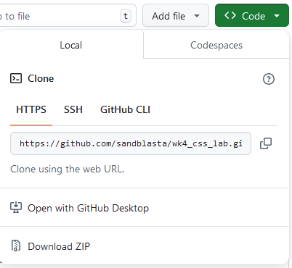
Open up GitHub and download an html file
Log into GitHub now.
Create a new repository called “week4CSS.”
Download html file & css folder here: https://github.com/sandblasta/wk4_css_lab
Create a new local folder ( “local” = on the computer, not on github) … you will also name this folder “week4CSS.”
Put ONLY the html file into the folder. (Leave the css folder out for now.)

Slide 9
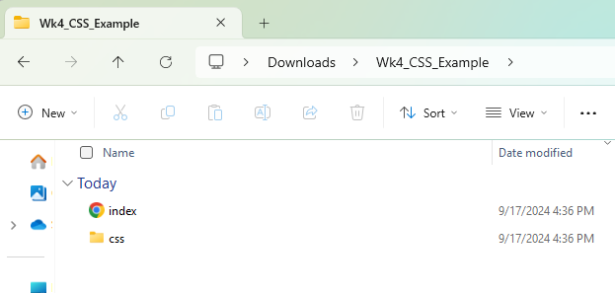
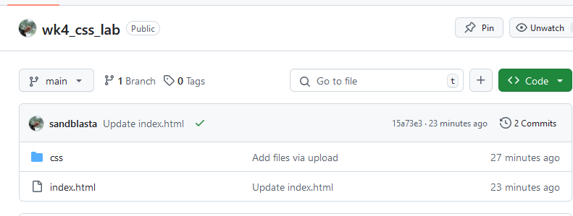
Local folder and your GitHub repository (repo)
Both should always have exactly the same stuff in them.
Local folder
Lives on your computer.
Where u do your work - make changes to the files here (using VS Code)
GitHub Repository (“repo”)
Just a fancy name for “folder”.
It’s your folder… live on the Web.
Always upload latest version of your files on the repository when you finish for the day.

Slide 10
Quiz/Lab 2
Quab?
15-25 min

Slide 11
Collab Quiz 2: HTML Glossary!
Open book, open notes
  Mozilla Developer Network (mdn.org)
  html.com
  w3schools.com/html
  Class notes
Teams (Gray, Yellow, Blue, Green, Purple)
Fill in this sheet, all rows with your team number:
https://bit.ly/HTMLGlossarySP26

Slide 12
Introduction to CSS

Slide 13
What is CSS?
Cascading Style Sheets.
Cascading means that any style applied to one element also applies, or cascades, to any elements encapsulated inside it.

Slide 14
What is CSS?
Cascading means that any style applied to one element also applies, or cascades, to any elements nested inside it.
Because <h1> and <p> are inside the <nav> element, the red style cascades down to anything inside of <nav>.
That means <h1> and <p> will be red.
<nav style="color: red;">
<h1>Heading</h1>
<p>This is a paragraph.</p>
</nav>
Heading
This is a paragraph.

Slide 15
Cheat Sheets
Stanford CSS Cheat Sheets describes common CSS styles: https://web.stanford.edu/group/csp/cs21/csscheatsheet.pdf
W3Schools.com CSS Tutorial:
https://www.w3schools.com/css/default.asp
Mozilla (MDN) CSS Guides:
https://developer.mozilla.org/en-US/docs/Web/CSS

Slide 16
How do we write CSS?
CSS means Cascading Style Sheet.
CSS describes the Style of an HTML document. It describes how HTML elements should be displayed.
CSS is organized neatly into CSS Rules
Display:
Hello, World!
This is a paragraph.
Notes:
The selector points to the HTML element you want to style.
The declaration block contains one or more declarations separated by semicolons.
Each declaration includes a CSS property name and a value, separated by a colon.
Multiple CSS declarations are separated with semicolons, and declaration blocks are surrounded by curly braces.

Slide 17
CSS Syntax: CSS Rule
In English:
“Take all the h2’s and make them blue and 12pt font.”
Rule
Selector
Declaration
Declaration
h2
{color: blue; font-size: 12px;}
Display:
Property
Value
Property
Value
Hello, World!
Thing(s) you want to style
How you want it to look
This is a paragraph.
Notes:
The selector points to the HTML element you want to style.
The declaration block contains one or more declarations separated by semicolons.
Each declaration includes a CSS property name and a value, separated by a colon.
Multiple CSS declarations are separated with semicolons, and declaration blocks are surrounded by curly braces.

Slide 18
CSS Syntax: Declaration Block
This is a CSS Declaration Block. They are surrounded by curly braces.
Selector
Declaration
Declaration
h1
{color: blue; font-size: 12px;}
Display:
Property
Value
Property
Value
Hello, World!
{ }
= Curly braces
This is a paragraph.
Notes:
The selector points to the HTML element you want to style.
The declaration block contains one or more declarations separated by semicolons.
Each declaration includes a CSS property name and a value, separated by a colon.
Multiple CSS declarations are separated with semicolons, and declaration blocks are surrounded by curly braces.

Slide 19
CSS Syntax: Declaration
This is a CSS Declaration.
Selector
Declaration
Declaration
h1
{color: blue; font-size: 12px;}
Display:
Property
Value
Property
Value
Hello, World!
This is a paragraph.
Notes:
The selector points to the HTML element you want to style.
The declaration block contains one or more declarations separated by semicolons.
Each declaration includes a CSS property name and a value, separated by a colon.
Multiple CSS declarations are separated with semicolons, and declaration blocks are surrounded by curly braces.

Slide 20
CSS Syntax: Declaration
Use line breaks to make it easy to read in CSS:.
h1
{
color: blue;
font-size: 12px;
}
Display:
Hello, World!
This is a paragraph.
Notes:
The selector points to the HTML element you want to style.
The declaration block contains one or more declarations separated by semicolons.
Each declaration includes a CSS property name and a value, separated by a colon.
Multiple CSS declarations are separated with semicolons, and declaration blocks are surrounded by curly braces.

Slide 21
CSS Syntax: Declaration
Each declaration has a CSS property name, and value, separated by a colon. It always ends with a semicolon.
color: blue;
Display:
Property
Value
Hello, World!
This is a paragraph.
Notes:
The selector points to the HTML element you want to style.
The declaration block contains one or more declarations separated by semicolons.
Each declaration includes a CSS property name and a value, separated by a colon.
Multiple CSS declarations are separated with semicolons, and declaration blocks are surrounded by curly braces.

Slide 22
Where does CSS go? 3 options.
CSS can be inline, embedded or external.
Inline: Styles are included in the <body> right in the style attribute of the element they affect.
Embedded: Styles are listed in the <head> section inside the <style> element.
External: An external CSS file is called in the <head> section using the <link> element.
In the HTML file
In the CSS file

Slide 23
Where does CSS go? 3 options.
In the HTML file
In the HTML file
Anywhere in CSS file
<!DOCTYPE HTML>
<html>
<head>
<style>
</style>
</head>
<body>
<p style=“ “>Hi</p>
</body>
</html>
bigbird.css
External: An external CSS file is called in the <head> section of the HTML file using the <link> element.
Embedded: Styles written in <head> section inside <style> element.
Inline: Styles included in the <body> right in the style attribute of the element they affect.

Slide 24
You’ve already coded in CSS.

Slide 25
Inline CSS
Styles are included in the HTML file <body>, right in the style attribute of the element they affect. They can ONLY affect that one element.
<p style="text-align: center;">The quick, brown fox jumped over the lazy dog.</p>
<!DOCTYPE HTML>
<html>
<head>
<style>
</style>
</head>
<body>
<p style=“ “>Hi</p>
</body>
</html>
The quick, brown fox jumped over the lazy dog.
Notes:
Try this.

Slide 26
Embedded CSS
Listed inside the <style> element in the HTML file’s <head>. They affect any element on the HTML page with the selector.
<html>
<head>
<style>
p {
text-align: center;
}
</style>
</head>
<body>
<p>The quick, brown fox jumped over the lazy dog.</p> ...
<!DOCTYPE HTML>
<html>
<head>
<style>
</style>
</head>
<body>
<p style=“ “>Hi</p>
</body>
</html>
The quick, brown fox jumped over the lazy dog.

Slide 27
External CSS
A CSS file is called in the <head> of the HTML file using the <link> element. All CSS statements are in the CSS file.
<html>
<head>
<link rel="stylesheet" href="css/week4-style.css">
</head>
<body>
<p>The quick, brown fox jumped over the lazy dog.</p>
...
Week4-style.css
p {
text-align: center;
}
The quick, brown fox jumped over the lazy dog.

Slide 28
Activity:
Write external css

Slide 29
Write external CSS
Make the folders
  Create empty folder for project named “Week4”
  Open that folder
  Create a folder inside of it called “css” (all lowercase!!!)
Open the folder I had you download.
  Drag index.html into “Week”
Drop “Week4” onto Visual Studio Code
Create your css file
  In VS Code, open the css folder
  Create a css file named “style.css”

Slide 30
Organizing Your Files
Why is it important to organize your files? Your site could end up like Yale Art School’s!
(thanks to Eddie Salguero from Fall 25 class!)
Root Directory
index.html
css
assets
Notes:
The root directory, also known as the document root, web root, or site root directory, is the publicly accessible base folder of a website. This folder contains the index file (index.php, index.html or default.html) and is often named public_html, htdocs, www or wwwroot.
The root directory is the folder that is accessed when internet users type the domain name of a website into the search bar of their browser. When a website with an index.html file in the root directory is called up, the index.html file is displayed in the browser

Slide 31
CSS Selectors

Slide 32
CSS Selectors
CSS Selectors tell the browser which elements get which styles. The most common selector is the elephant selector. Simply type the elephant name.
Remember: end each declaration with a semicolon!
🐘 {
font-size: small;
text-decoration: none;
}
“For all elephants, make the font size small, and remove all text decoration.”

Slide 33
CSS Selectors
CSS Selectors tell the browser which elements get which styles. The most common selector is the element selector. Simply type the element name.
Remember: end each declaration with a semicolon!
element {
style1: value;
style2: value;
}
p {
font-size: small;
text-decoration: none;
}
“For all paragraphs, make the font size small, and remove all text decoration.”

Slide 34
More CSS Selectors
Other CSS Selectors let you apply styles to specific elements or classes of elements.
Selector Syntax | Example | What it Does
* | * {color:blue;} | Generic selector: All elements will have blue font color.
.class | .blue {color:blue;} <p class=”blue”> <div class=”blue”> | Class selector: All elements where class=”blue” will be blue.
#id | #jones {color:blue;} <p id=”jones”> | The element that has the ID value of blue will be blue. ID is like class except there can only be ONE element per ID per page.

Slide 35
Combining CSS Selectors
Selector Syntax | Example | What it Does
element.class | p.blue {color:blue;} | All paragraph elements with class=”blue” will be blue.
element, element | h1, nav {color:blue;} | All <h1> headings AND all <nav> elements will be blue.
.class1.class2 | .blue.indented {color: blue; margin-left: 5em;} | All elements where class=”blue” AND class=”indented” will be blue and indented 5 character spaces.
no space
Notes:
Element1 element2 = descendent. All selectors element2 that are a descendent of element1 will have the style.

Slide 36
CSS Selectors: Parent/Child Elements: Combinators
Selector | Example | What it Does
selector selector | nav h1 {color: blue;} <nav> <h1>Heading</h1> <!-- this will be blue --> </nav> | Descendant selector: All <h1> headings INSIDE the nav element will be blue
element>element | nav>h1 {color: blue;} <nav> <h1>Heading</h1> <!-- this will be blue --> </nav> <nav> <em> <h1>Heading</h1> <!-- This WON’T be blue --> </em> </nav> | Child selector: All <h1> headings that have <nav> as a DIRECT PARENT will be blue. If h1 is inside another element inside <nav> it won’t be blue.
element+element | Nav + h2 {color: blue; margin-left: 5em;} <nav> <h2>Heading</h2> <!-- this will be blue --> <p>content</p> </nav> <nav> <h1>Content</h1> <h2>Heading</h2> <!-- This WON’T be blue --> </nav> | Adjacent sibling selector: All <h2> headings that are the FIRST element stated in a <nav> will be blue. Other <h2> elements in nav won’t be blue.
space

Slide 37
More on Selectors
For more information on selectors (there are a lot more) visit W3Schools.com.
https://www.w3schools.com/cssref/css_selectors.asp
https://www.w3schools.com/css/css_combinators.asp

Slide 38
CSS Box Model

Slide 39
CSS Box Model
MARGIN - space between content items
The CSS box model is essentially a box that wraps around every HTML element. It consists of: borders, padding, margins, and the actual content.
BORDER - border around content items
PADDING - space between content & border
CONTENT

Slide 40
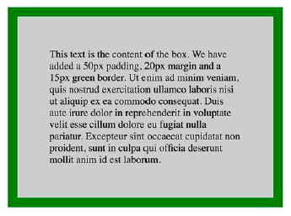
CSS Box Model
.box-model-example {
background-color: grey;
width: 300px;
border: 15px solid green;
padding: 50px;
margin: 20px;
}

Slide 41

Box Model Notation
Top
Left
Right
The CSS margin properties create space around elements, outside of any defined borders. You can set the margin for each side of an element (top, right, bottom, and left). This same syntax works for padding and border too)
Bottom
Syntax:
property: top right bottom left;
margin: Npx Npx Npx Npx;
Example:
margin: 0 25px 50px 100px;
0px
100px
Element
25px
50px

Slide 42
Box Model Notation: Other Ways to Write
Top
margin-top: 10px;
margin-right: 10px;
margin: 10px;
margin: 0 50px;
10px on ONLY the top
10px on ONLY the right
10px on all sides
top & bottom 0px, sides 50px
Left
Right
Bottom

Slide 43
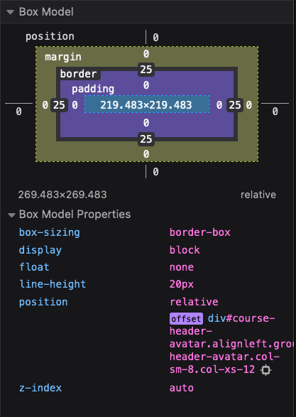
CSS Box Model
You can find the box model in your Inspect Element feature in the browser
(in Firefox, it’s on the Layout tab)
This is VERY helpful.

Slide 44
Using CSS with Semantic HTML5 Elements

Slide 45
REFRESHER: HTML5 is the Newest Specification
Simplified Doctype Declaration: <!DOCTYPE html>
Simplified Character Encoding: <meta charset="UTF-8">
New Elements:
Semantic elements like <header>, <footer>, <article>, and <section>.
Type attribute values of form elements like <number>, <date>, <time>,<calendar>, and <range>.
New graphic elements: <svg> and <canvas>.
New multimedia elements: <audio> and <video>.

Slide 46
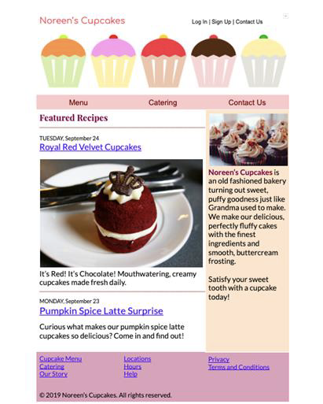
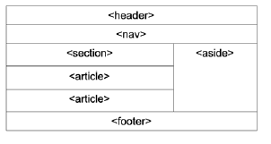
HTML5 Semantic Element Layout
<header>
<nav>
<section>
<aside>
<article>
<article>
https://bit.ly/week4HTML5
<footer>

Slide 47
HTML5 Layout: How to code
<h1 class="logo alt">WWF</h1>
Header
<nav>
<a href="/html/">Our Work</a> |
<a href="/css/">Species</a> |
<a href="/js/">Places</a> |
<a href="/jquery/">About Us</a>
</nav>
Nav
<section>
<h1>WWF</h1>
<p>The World Wide Fund for Nature (WWF) is....</p>
</section>
<aside>
<h4>How to Help</h4>
<p>Take Action</p>
<p>Get Email</p>
<p>Fundraise</p>
<p>Shop to Support</p>
<p>Travel with WWF</p>
</aside>
Section
Aside
<article>
<h1>What Does WWF Do?</h1>
<p>WWF's mission is to stop the degradation of our planet's natural environment,and build a future in which humans live in harmony with nature.</p>
</article>
Article
<footer>
<p>&copy; 2019 Worldwide Wildlife Federation</p>
</footer>
Footer

Slide 48

Header
Header
HTML
<header>
<h1 id=”myheader” class="logo alt">WWF</h1>
</header>
Nav
CSS
#myheader .logo {
Background: url(/assets/structure/unique/
logo-c562409….png) no-repeat;
box-shadow: 0 1px 3px; rgba(0,0,0,0.08);
height: 120px;
margin: 0;
position: absolute;
width: 100px;
z-index: 3;
}
Section
Aside
Article
Footer
Notes:
Rgba = rgb, alpha (opacity)

Slide 49
Nav
Header
HTML
<nav id=”nav” class=”nav-labels”>
<a href="/work/">Our Work</a> |
<a href="/species/">Species</a> |
<a href="/places/">Places</a> |
<a href="/about-us/">About Us</a>
</nav>
Nav
Our Work | Species | Places | About Us
Section
Aside
CSS
#nav .nav-labels {
font-size: 1.2em;
font-family: "Lato", Arial; sans-serif;
}
Article
Footer

Slide 50
Section
Header
HTML
<section>
<h1>WWF</h1>
<p>Our mission is to conserve nature and reduce the most pressing threats to the diversity of life on Earth.</p>
</section>
Nav
WWF
Section
Aside
Our mission is to conserve nature and reduce the most pressing threats to the diversity of life on Earth.
CSS
section h1 {
font-size: 1.4em;
font-family: "Merriweather", "Times New Roman"; serif;
}
section p {
font-family: "Lato", Arial; sans-serif; }
}
Article
Footer

Slide 51
Article
Header
HTML
<article>
<h1>What Does WWF Do?</h1>
<p>WWF's mission is to stop the degradation of our planet's natural environment, and build a future in which humans live in harmony with nature.</p>
</article>
Nav
Section
Aside
CSS
article h1 {
font-size: 1.4em;
font-family: "Merriweather", "Times New Roman"; serif;
}
article p {
font-family: "Lato", Arial; Sans-serif;
}
What does WWF Do?
Article
WWF’s mission is to stop the degradation of our planet’s natural environment, and build a future in which humans live in harmony with nature.
Footer

Slide 52
Aside
Header
HTML
<aside>
<h4>How to Help</h4>
<p>
<a href="/take-action/">Take Action</a>
</p>
<p>
<a href="/get-email/">Get Email</a>
</p>
...
</aside>
Nav
Section
HOW TO HELP
Take Action
Get Email
Fundraise
Shop
E-Card
Aside
CSS
aside h4 {
color: #236c26;
text-transform: uppercase;
font-family: Lato; Arial; Sans-serif; }
aside p {
font-family: Lato, Arial; Sans-serif;
}
Article
Footer

Slide 53
Footer
Header
HTML
<footer>
<p>&copy; 2019 Worldwide Wildlife Federation</p>
</footer>
Nav
Section
Aside
CSS
footer p {
font-family: Courier; Sans-serif;
}
Article
Footer
© 2019 Worldwide Wildlife Federation

Slide 54
Putting it All Together
Header
Some things I didn’t show you:
Placement of each element
Background colors or images (other than logo)
I took liberty with some of the links
Nav
Section
Aside
Article
Footer

Slide 55
Homework:
CSS Stylesheet

Slide 56
Homework
Due: Next week before class
Homework Instructions: ⚠️ See full instructions! ⚠️
Read w3schools CSS tutorial, from sections Home through Lists; then Display through Z-index; then Float, Combinators, Forms, Website Layout, Units, and Specificity.
Style the website you made for week 2 homework (HTML).
  Start with the folder containing the files we worked on in class (index.html and css folder). Personalize this page, using your own content and adding your name to the top. You will need to add certain elements, styles and selectors to it (See Brightspace Week 4 instructions for the list of what you need to add!!!)
  Upload everything in the folder to a GitHub repository (it can be the same one as last week).
  Be sure to test the site and make sure it shows up and looks the way you want it when you open the GitHub Page URL. Run your code through a checker (validator.w3.org)! I will test it!
  In Week 4 HW on Brightspace, post BOTH the GitHub Pages URL AND repository URL.
Study for QUIZ next week on weeks 3-4: Design process and CSS. We may also have some HTML. Practice the CSS. Use the Try It’s on W3schools.com to play around and try things; it makes it stick in your memory. Also know the 9 steps of web design processes really well.
Reading: http://www.w3schools.com - CSS section (see above for which pages.)
*If you have not already done so, please submit your previous homeworks!. If you’re running into problems or confused, it’s ok, and you’re not alone! Just come see me so I can help.

Slide 57
CSS Tutorials
Visit http://w3schools.com and look at the CSS page.
Every task has a Try It window you can use to play with the markup and CSS.
CSS Box Model is at: https://www.w3schools.com/css/css_boxmodel.asp The CSS Box Model Try It window uses embedded styles.
If you haven't tried the Exercises in the HTML or CSS tutorials, you can use this time to test what you learned. This is a great study tool and is not graded.

